Slide 1

Processing and Storage of Samples for Metabolomics Assays
Kathleen A. Stringer, PharmD
College of Pharmacy
University of Michigan

Slide 2
Outline
Briefly discuss sample collection since it is the first step of sample processing
Highlight key points and considerations for sample storage
Use the example of whole blood extraction to illustrate sample processing for untargeted metabolomics by NMR
Discuss the importance of biobanking/biorepositories for metabolomics research

Slide 3
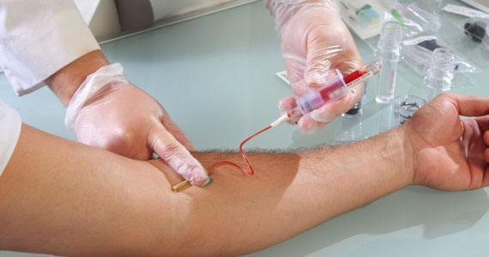
Sample Collection
The first step in sample processing
  depends on the type of sample
  depends on the source of the sample
    clinical vs. experimental
Consistency is key
  uniformity of supplies
  standard operating procedures (SOP)
  prospective collection vs. samples of convenience
Universal “standards” do not yet exist but will be driven by the advancement of metabolomics technology
image from www.usada.org

Slide 4
Sample Collection
Variables to consider:
  time of day and circadian variation
  gender and age of subjects (mammalian)
  diet, hydration, fasting state, exercise/activity
Time (h)
Collection vessel
  glass vs. plastic
  laboratory vs. clinic
  presently there are no “metabolomics tubes”
image adapted in part from D. Wishart, Bioinformatics.ca; June 13, 2011 under a creative commons license
Slupsky, CM., et al. Anal Chem 2007;79:6995-7004
Park, Y., et al. Am J Physiol Regul Integr Comp Physiol 2009;297:R202-9

Slide 5
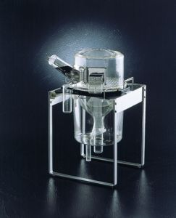
Urine Sample Collection
Urine
  for human samples collect a midstream, “clean catch” specimen
  for animals (e.g., 3-4 mice/metabolic cage) a 12-24h is needed for sufficient volume
    timeframe from experiment to experiment should be consistent
  combat bacterial contamination with sodium azide (10%)
urine collection vessel of metabolic cage (mice)
image from http://www.tecniplast.it/usa/

Slide 6
Urine Sample Processing
Following collection, measure volume (can store sample at 4°C for up to 3h)
Centrifuge (4°C, 2000 x g, 10 min) to precipitate sediment.
Transfer the supernatant into a sterile tube taking care not to disturb the bottom of the tube whether there is a visible pellet or not. Discard the pellet and ~50µL (mouse) or ~500 μl (human) of sample above it.
Keep samples and tubes on ice during processing

Slide 7
Urine Sample Processing
Transfer 500µL-1mL of urine to a clean microcentrifuge tube (1.5mL) and store (-80°C). This is a sample that can be reserved for LC-MS analysis.
Accurately measure the remaining total sample volume in the tube. Record the volume.
Add a volume of buffered internal standard (IS) equivalent to 10% of the final sample volume
  Na or K phosphate buffer (pH 7.4) containing 10mM DSS
  Chenomx IS-1 (sample should be pH’d to 7.0 before addition)
Following the addition of IS, cap the tube and invert 4X to thoroughly mix.
Generate technical replicates (500µL) and freeze (-80°C).
At this point, sample can be aliquoted and frozen.
Chenomx software is “pH sensitive.”

Slide 8
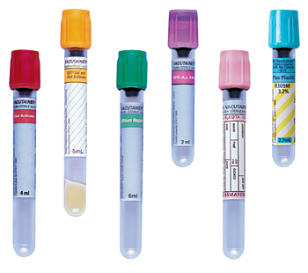
Blood Collection
Sample is collected in the absence of anti-coagulants.
  Serum must be “clotted” at room temperature for at least 30 min
Preservation of blood with heparin (for NMR)
  heparin containing blood collection tubes are not endotoxin-free
    use sodium heparin (rather than lithium heparin)
    use glass not plastic collection tubes (Vacutainer®)
    samples should be placed in an ice-water bath upon collection
  For the lab:
Whenever possible, generate technical replicates in addition to biological replicates
Newhall, KJ., et al. Clin Chem 2010;56:1483-91

Slide 9
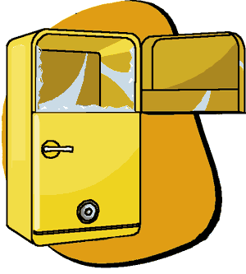
Sample Storage
Upon collection and in advance of assay
  most biofluids should be stored at -80°C (urine -40°C)
  samples (e.g., urine) that require pre-processing before storage should be kept cold (4°C)
  tissue, cell and other types of samples (e.g., sputum) processing is unique
Few data are available about specific metabolites
  most have been done in urine
Bernini, P., et al. J Biomol NMR 2011;49:231-43
Yuille, M., et al. Biopreserv Biobank 2010;8:65-9
Beckonert, O., et al. Nature Protocols 2007;2:2692-2703
image from commtechlab.msu.edu

Slide 10
Sample Stability
Freeze-thaw
  aliquot technical replicates to avoid freeze-thaw
Storage duration: Some metabolites may be more vulnerable than others and this may vary based on sample type
Metabolite stability in complex biological samples
  should be part of quality control measurements in conjunction with analytical variability

Slide 11
Sample Stability
Breier, M., et al. PLoS One 2014;9:e89728

Slide 12
NMR Assay of Un-extracted Plasma and Serum Samples
Best approach for the analysis of very low volume (<200 uL) samples
For water-soluble profiling only (using a unique water-suppression and macro-molecule suppression techniques)
The limitations of this approach:
  protein and lipoprotein signals obstruct regions of the spectrum and the detection of low-abundant aqueous metabolites
  no specific lipid information
  quantification of individual metabolites is difficult
ppm
image from Beckonert, O., et al. Nature Protocols 2007;2:2692-2703

Slide 13
Methanol:Chloroform Extraction
Advantages:
Protein removal (not complete)
Allows for dual-platform assays
Ideal for untargeted quantitative metabolomics of aqueous and lipid metabolites (required for use of Chenomx software)
Disadvantages:
Time consuming (> 24 h)- not “real time”
Metabolite recovery
Beltran, A., et al. Anal Chem 2012;84:5838-44

Slide 14
Methanol:Chloroform Extraction
Whole Blood Extraction SOP
Biomaterials Required:
~0.5 to 1.0 mL plasma/serum or whole blood (per sample) collected with heparin*
Other reagents and solutions:
Methanol and chloroform (reagent or HPLC grade) mix 1:1 (volume) fresh in a tightly sealed (Corning screw top bottle) that has been pre- cooled (-20°C); store mixture (-20°C) so it is ice cold when ready for use
  Ice cold DI water
Preservative will vary depending on planned analytical platform

Slide 15
Methanol:Chloroform Extraction
A few things to keep in mind…
Use glass graduated cylinders and Pasteur pipets and the glass serological pipets for methanol and chloroform measurements.
All samples and solutions must be kept on ice or in the refrigerator at all times!
Only use glass pipettes for transferring!
Pre-chill all tubes/reagents in ice or in -20°C before use!

Slide 16
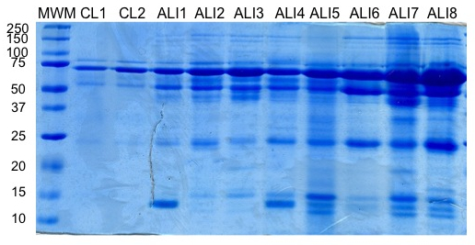
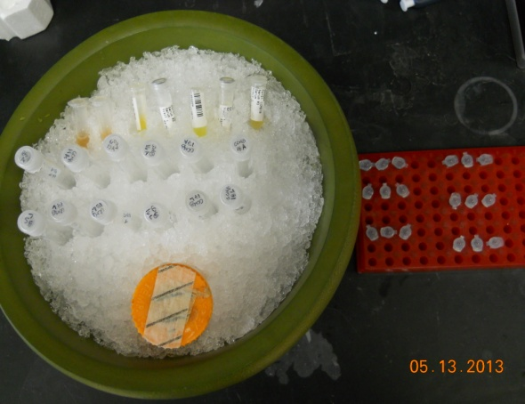
Methanol:Chloroform Extraction
Thaw samples in the fridge (4°C) and mix needed reagents/solutions.
Label two glass tubes for each sample; put the second set of tubes in the fridge (4°C).
Gently invert sample tubes (DO NOT VORTEX) and, if desired, remove three 10uL aliquots and add to labeled microcentrifuge tubes for BCA, Coomassie Gel and proteomics analysis. Freeze these aliquots at -80°C.
Add 500µL of sample to each glass tube labeled with “A.” Record the actual volume that goes into each tube. This can vary if a clot has formed in the sample. Keep samples on ice.

Slide 17
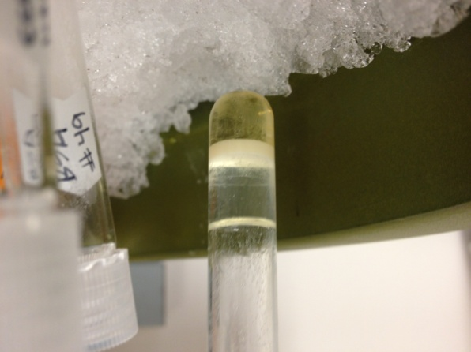
Methanol:Chloroform Extraction
Add 1mL of cold methanol:chloroform to each tube, cap and vortex thoroughly. Be careful not to let the methanol:chloroform come in contact with the tube cap. The caps are not solvent-tight.
Centrifuge tubes at 1300 x g, 4°C for 20 min.
Following centrifugation, transfer the supernatant and lower fluid layer to the second labeled tube (“L”)(keep on ice). The samples may form a pellet and supernatant, or a supernatant, solid layer and lower layer of fluid. Either is acceptable, just be sure to remove all fluids leaving only the pellet (it doesn’t matter of you get some of the pellet). Reserve this fluid layer in the refrigerator (4°C) or on ice. Pellets from whole blood samples will be larger and harder than those of serum or plasma.
Representative sample at step 7. Transfer both the top and bottom layers to the “lipid” tube.

Slide 18
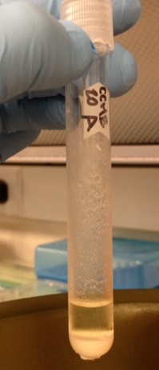
Methanol:Chloroform Extraction
Resuspend the pellet of each sample in cold methanol:chloroform (0.5mL). Vigorously vortex to break up as much of the pellet as possible. Centrifuge (1300 x g, 4°C for 20 min).
Collect the supernatant (at this point, there should only be a supernatant and pellet but there may be some “floaters”) and add it to the fluid layer that was reserved in step 6. Reserve pellet and any floaters.
Sample at step 9. Add all supernatant to the fluid layer reserved in step 6.

Slide 19
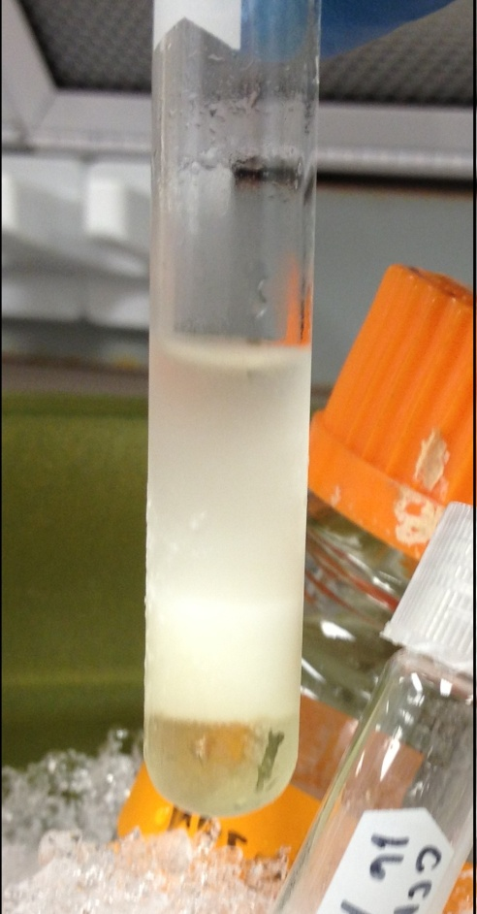
Methanol:Chloroform Extraction
Add 0.5mL of ice-cold DI water to each of the fluid tubes. Vortex well.
Cool the fluid for 20 minutes at -20°C. ALWAYS cool for exactly 20 minutes. If you should run over, remove tubes from the freezer re-vortex and repeat this freezing step (step 10). You don’t want the aqueous phase to freeze. Ice crystals will form and precipitate in the organic phase and this will lead to erroneous results. If the sample freezes, thaw it (4°C) and repeat step 10.
The tubes containing the pellet can also go in the freezer (-20°C) at this point (step 10).
Upon removal of the tubes from the freezer, add 0.5mL of ice-cold DI water to the tubes containing pellet. Suspend the pellet by vigorously vortexing or use a spatula as needed.
After the 20min freezer incubation, the fluid samples will have separated into a supernatant, aqueous top layer and a protein layer (see figure 3). Add the top layer to the resuspended pellet (step 12). Do not disrupt or penetrate white protein layer. This remaining protein layer and lower liquid layer is the lipid fraction which can be capped and placed in the fridge (4°C).
1
2
3
Step 14. Transfer layer 1 to the “aqueous” tube.
1. Aqueous top layer
2. Protein layer
3. Lipid layer

Slide 20
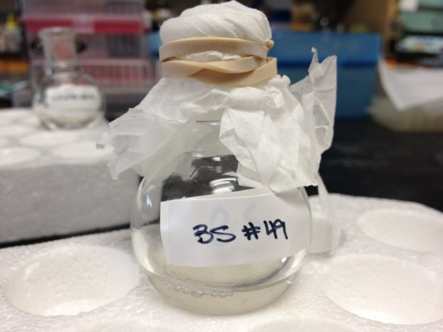
Methanol:Chloroform Extraction
Vortex the tubes containing the pellet and the newly added aqueous top layer (these are the water soluble samples) and centrifuge (1300 x g, 20 min, 4°C).
Transfer the supernatant to a lyophilizer bulb/flask. Cover with lid or parafilm.
Add 0.5mL ice cold DI water to pellet and resuspend as in step 10 and centrifuge (1300 x g, 20 min, 4°C).
Transfer the supernatant to the existing samples in the lyophilizer bulbs and discard the pellet.
Round-bottom flask (lyopholizer bulb) with aqueous fraction prior to lyophilization. Steps 16 and 18.

Slide 21
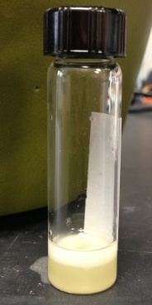
Methanol:Chloroform Extraction
Allow the water soluble fractions to sit in the lyophilizer bulbs for 5 min. Carefully observe each glass. If oil droplets have formed at the bottom of the glass, use a Pasteur pipet to remove them and add to the lipid fraction. Measure and record the volume in the glasses before freezing with glass serological pipet! NOTE: Add 1mL of DI water to each bulb to dilute out remaining methanol before freezing.
Freeze the lyophilizer bulbs in -80°C freezer while tilting the glasses if possible (do this by placing the bulbs in the lyophilizer flask, covering each bulb with kimwipes and placing in -80°C overnight). Lyophilize for at least 24 h to ensure that methanol is removed. Do not exceed 48 h.
Transfer the lipid fractions to the 3.7mL borosilicate vials (measure and record volumes using serological glass pipets) and dry the lipid fractions in a speedvac at 50°C on heat + IR setting for 1h or until dry – record time for each. Cap tubes, wrap in parafilm and store at -20°C (can be stored for months).
Alternatively, liquid nitrogen can be used; MeOH/dry ice is not a reliable alternative. Sample must be completely frozen.
This time may vary depending on lyophilizer model and relative humidity!
Borosilicate vial with protein and lipid bottom layer from step 21.

Slide 22
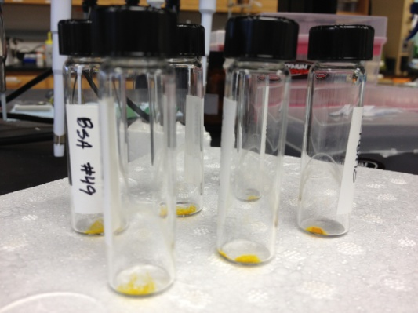
Methanol:Chloroform Extraction
When the water soluble samples are dry, they can be sealed with parafilm and stored (4°C) for up to a week. At the time of assay or for long-term storage, add 0.5mL of D₂O (record volume after resuspending) to each lyophilizer glass to resuspend sample. For assay, transfer each sample to an NMR tube for analysis. For long-term storage (years), transfer sample to a micro-centrifuge tube, seal with parafilm and store (-20°C).
At the time of assay of the lipid samples, discard cap, resuspend samples in 0.6mL 1:2 deuterium methanol:deuterium chloroform solution (volume to volume), cap with a new cap and centrifuge (1300 x g, 10 min, 4°C). Transfer supernatants to NMR tubes for assay.
Measure volume removed from lyophilizer bulb; add 10% DSS for NMR assay.
Speedvac-dried lipid fraction

Slide 23
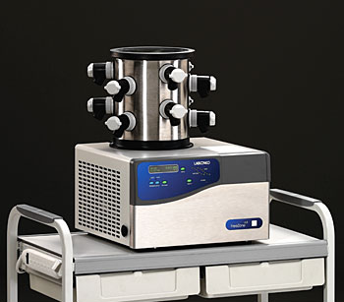
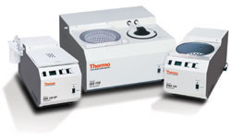
Equipment and Lab Requirements
Extraction of samples for metabolomics assays require:
  Lyopholizer
  “Speed vac”
Sufficient bench and ventilation hood space to accommodate these pieces of equipment

Slide 24
Technology will Drive the Field of Metabolomics
Automation of extraction process will reduce time of sample processing and improve consistency
Ellinger, JJ., et al. Anal Chem 2012;84:1809-12

Slide 25

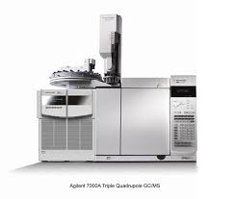
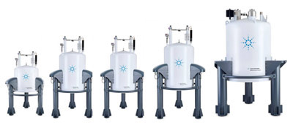
Other Extraction Methods
Ultrafiltration as an alternative to MeOH:CHCl₃
  aqueous metabolites
Perchloric acid (PCA) extraction for adherent cell culture and mammalian tissues (e.g., lung)
For targeted metabolomics and lipidomics
  assay and analytical platform dependent
images from Agilent.com

Slide 26
Biobanking/Biorepositories
Systematic collection and storage of human samples for “omics” research (and potentially clinical use)
  samples are collected and processed using SOPs
  storage conditions are monitored and documented
  QC processes are integrated from collection through processing, storage and assay
  samples are labeled (barcoded) and cataloged

Slide 27
Biobanking/Biorepositories
Circumvents use of samples of convenience
Creates an infrastructure for human systems biology research
  necessary for reliable biomarker discovery and validation studies
Best option for long-term reliable storage of samples
image from Poste, G. Nature 2011;469:156-7

Slide 28
Summary
Consistent, prospective sample collection is the first step of sample processing for the generation of reliable metabolomics data
Sample stability may vary based on type of biofluid/sample and overall stability of individual metabolites
Methanol:chloroform extraction of whole blood yields a aqueous and lipid fraction for untargeted metabolomics that can be used for NMR and LC-MS analysis
A move towards biobanking/biorepositories will improve overall reliability of clinical samples used for metabolomics assays

Slide 29

Acknowledgements
Stringer lab
  Mike Finkel
  Julie Trexel
  Larisa Yeomans
Computational Medicine & Bioinformatics
  Alla Karnovsky, PhD
Pulmonary & Critical Care Medicine
  Ted Standiford, MD
CoP Biochemical Nuclear Magnetic Resonance Core
Funding
  National Institute of General Medical Sciences (GM078200 08 & GM069438)
  Michigan Institute for Clinical and Health Research (MICHR; UL1RR024986)
  Michigan Regional Comprehensive Metabolomics Core (MRC²; U24 DK097153 of NIH Common Funds)

Slide 30
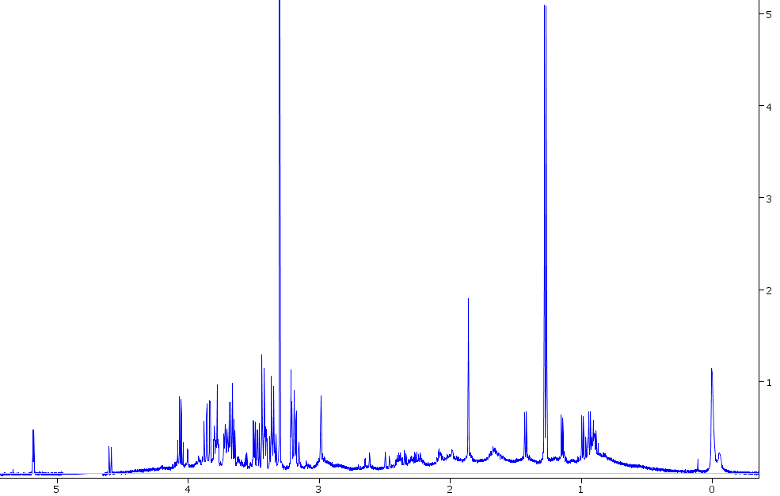
Methanol/Chloroform Extracted Serum
0.6mM DSS
Line width ~9.00Hz

Slide 31
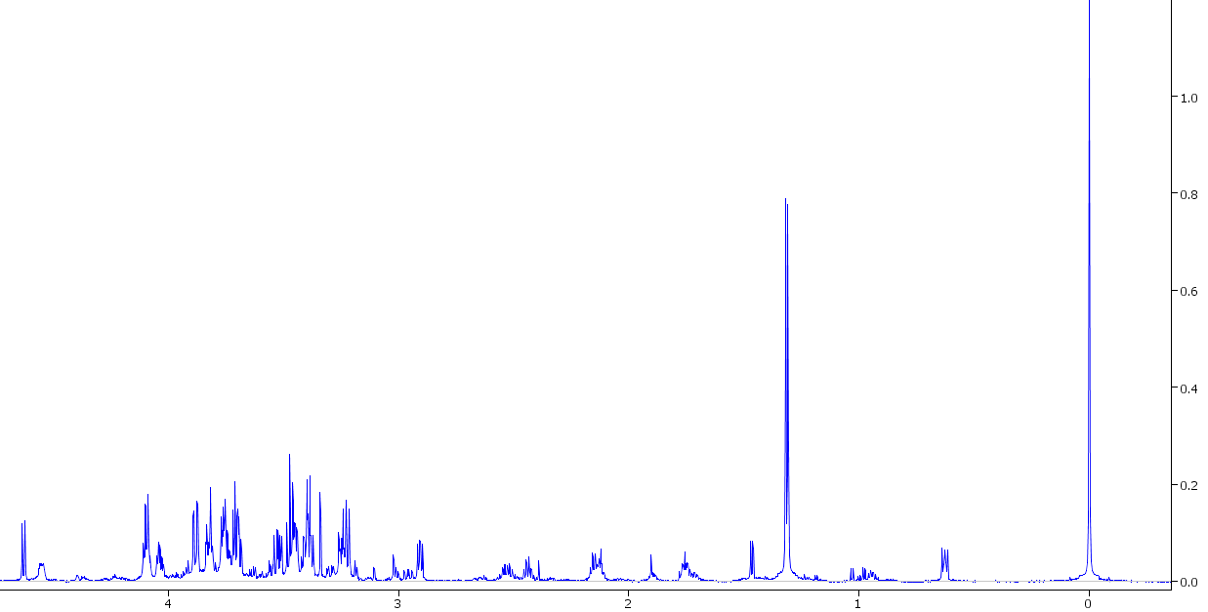
Methanol/Chloroform Extracted Whole Blood
0.6mM DSS
Line width ~1.7Hz

Slide 32
Added Step for Serum Samples
Seems that protein remains in the aqueous fraction of extracted serum samples only
After Chloroform/Methanol Extraction, filter serums with 3kDa Pall Centrifugal Devices

Slide 33
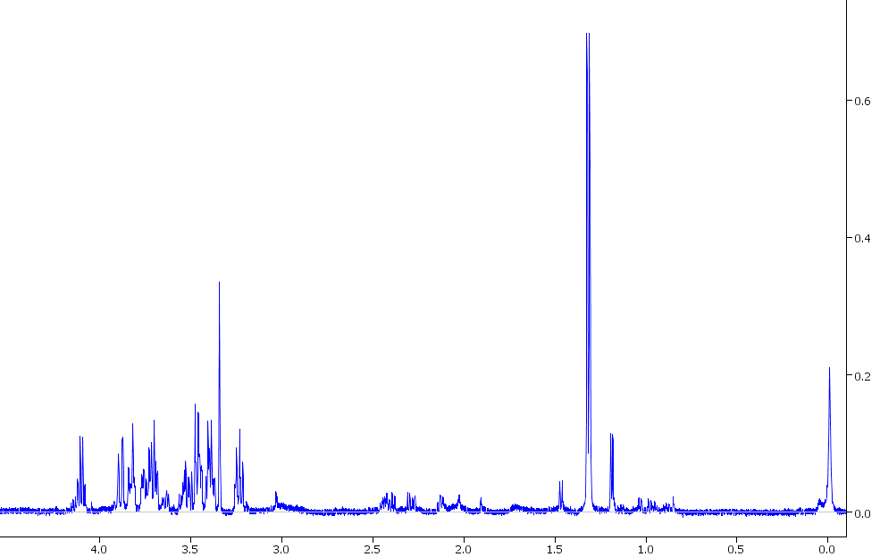
Extracted and Filtered Serum + DSS
DSS added after filtration
DSS methyl peak line width ~5.10Hz

Slide 34
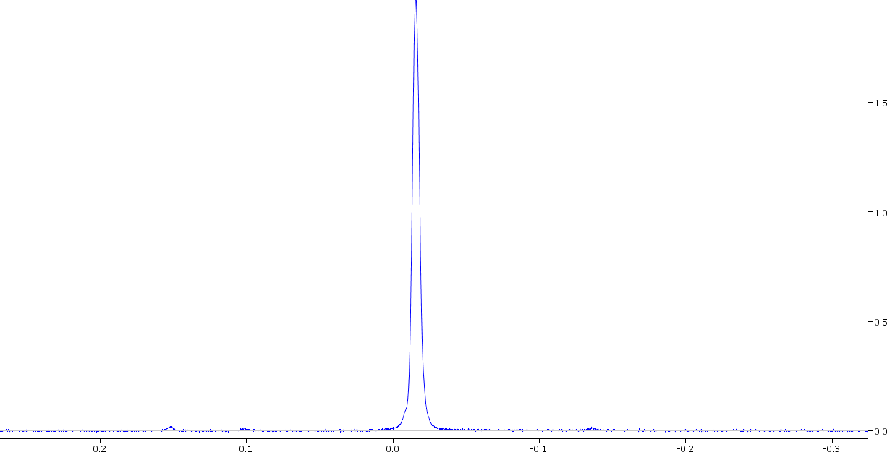
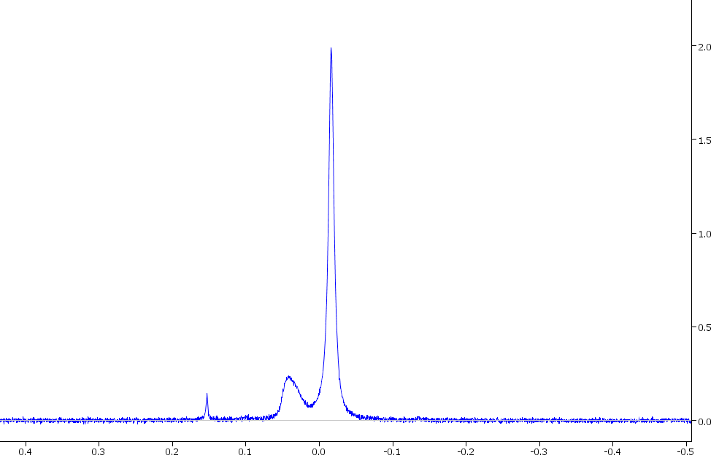
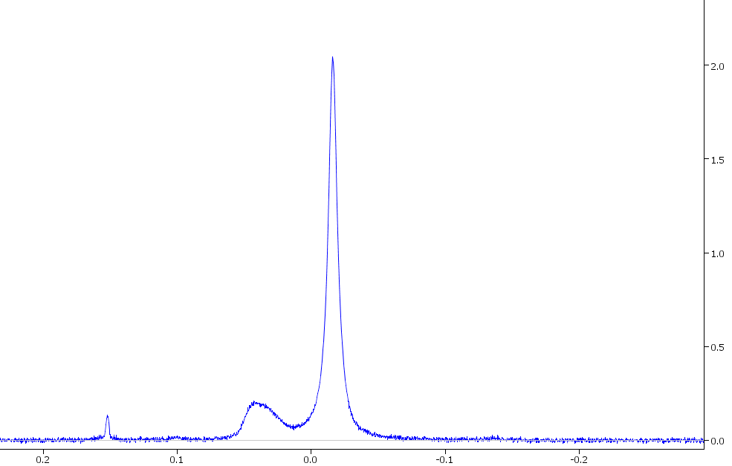
Same Phenomenon in Serum + TSP
50% LW ~2.5Hz
50% LW ~4.31Hz
3 separate extracted and filtered serum samples
TSP added after filtration in each case
50% LW ~4.13Hz

Slide 35
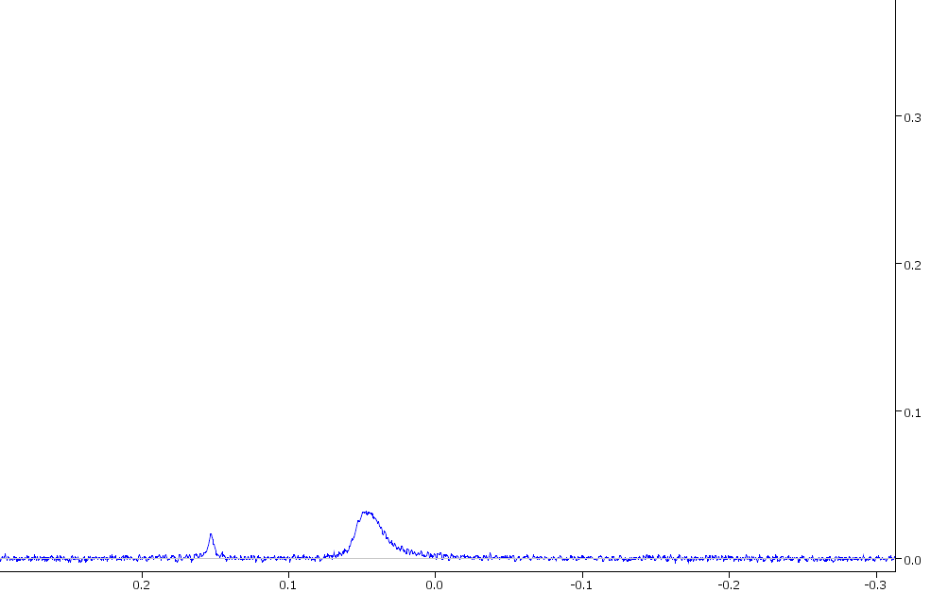
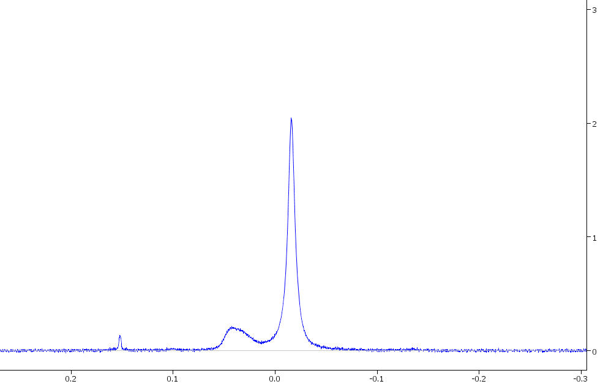
Overlap of Unknown Peak with Our Internal Standard Methyl Peak
Extracted and Filtered Serum without Internal Standard Added
Protein?
Lipid?
Extracted and Filtered Serum + TSP

